Slide 1
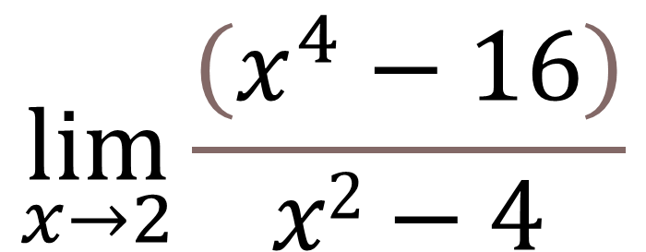
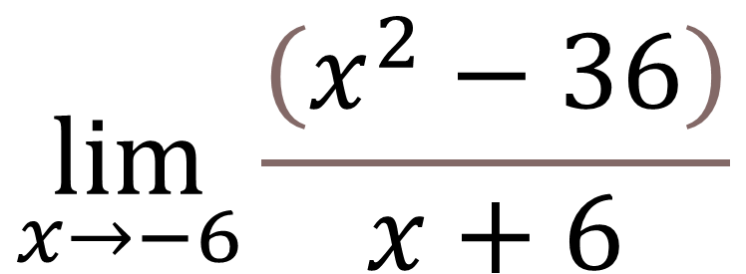
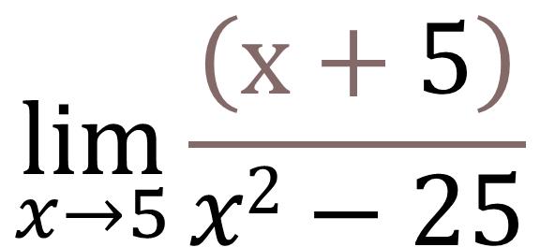
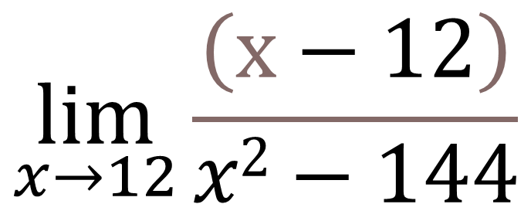
La suma por la diferencia
$$\lim_{x→2}\frac{\left(x^{4}−16\right)}{x2−4}$$
$$\lim_{x→−6}\frac{\left(x^{2}−36\right)}{x+6}$$
$$\lim_{x→5}\frac{\left(x+5\right)}{x2−25}$$
$$\lim_{x→12}\frac{\left(x−12\right)}{x2−144}$$

Slide 2
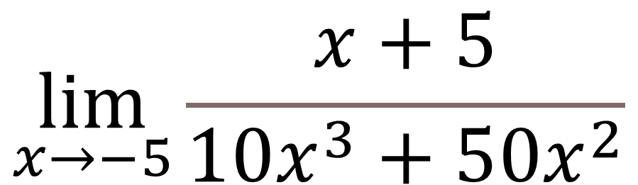
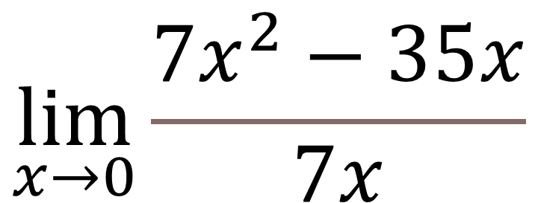
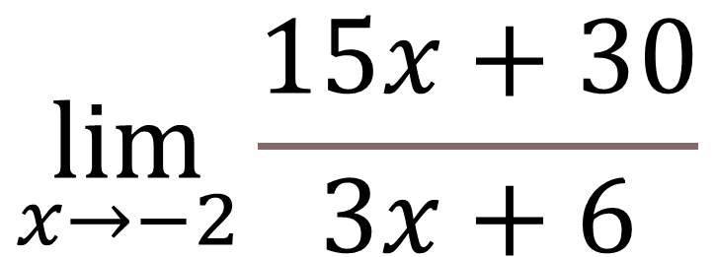
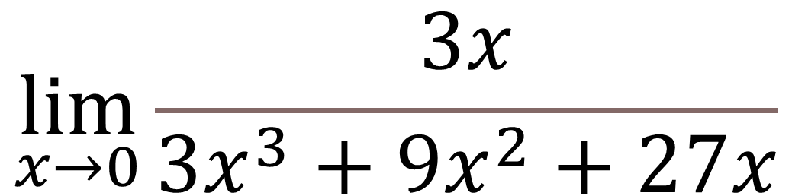
Factor común
$$\lim_{x→0}\frac{7x^{2}−35x}{7x}$$
$$\lim_{x→−2}\frac{15x+30}{3x+6}$$
$$\lim_{x→−5}\frac{x+5}{10x^{3}+50x^{2}}$$
$$\lim_{x→0}\frac{3x}{3x^{3}+9x^{2}+27x}$$

Slide 3
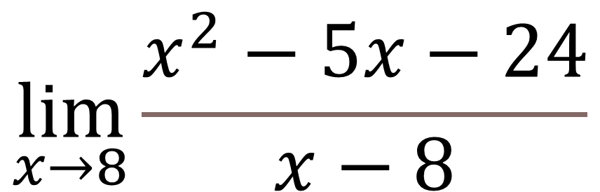
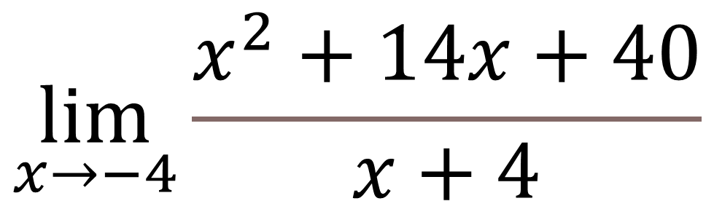
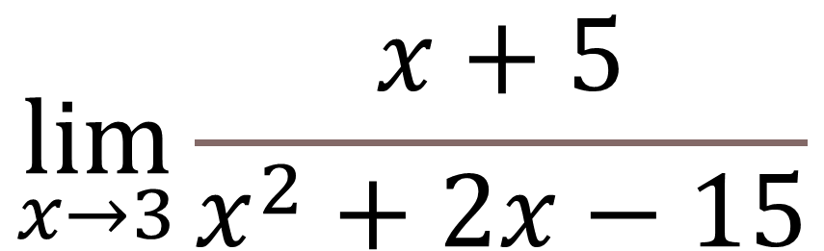

De la forma 1
$$\lim_{x→−4}\frac{x^{2}+14x+40}{x+4}$$
$$\lim_{x→8}\frac{x^{2}−5x−24}{x−8}$$
$$\lim_{x→3}\frac{x+8}{x^{2}+5x−24}$$
$$\lim_{x→3}\frac{x+5}{x^{2}+2x−15}$$

Slide 4
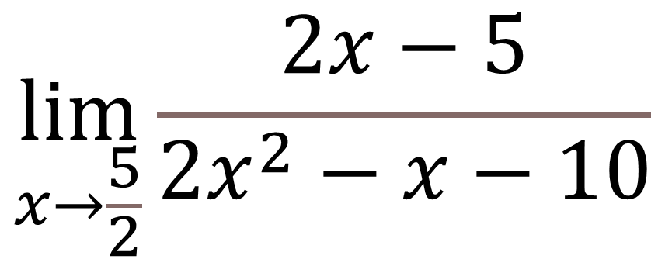
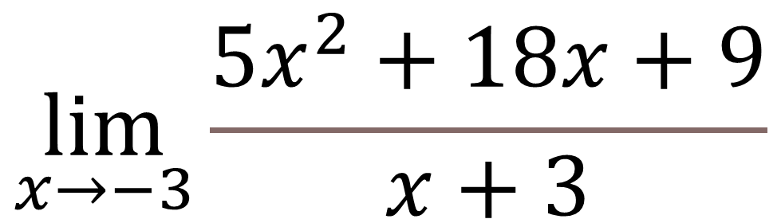

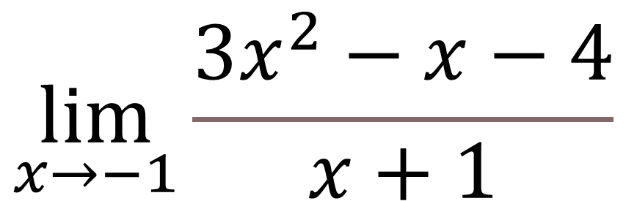
De la forma 2
$$\lim_{x→−3}\frac{5x^{2}+18x+9}{x+3}$$
$$\lim_{x→−1}\frac{3x^{2}−x−4}{x+1}$$
$$\lim_{x→\frac{5}{2}}\frac{2x−5}{2x^{2}−x−10}$$
$$\lim_{x→3}\frac{x−3}{4x^{2}−14x+6}$$

Slide 5
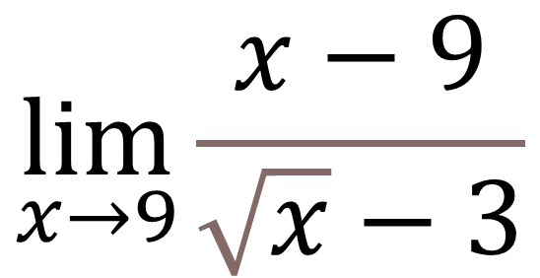
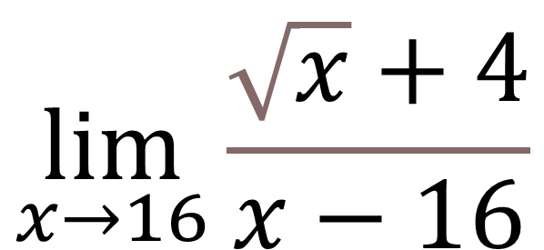
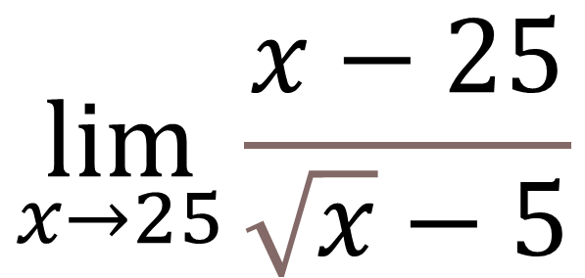
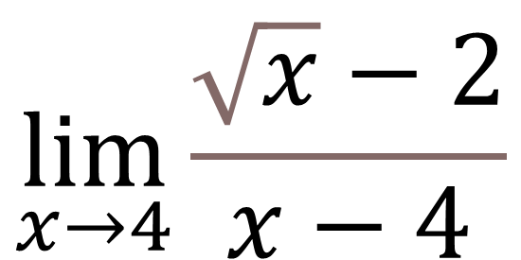
Radicales
$$\lim_{x→16}\frac{\sqrt{x}+4}{x−16}$$
$$\lim_{x→4}\frac{\sqrt{x}−2}{x−4}$$
$$\lim_{x→9}\frac{x−9}{\sqrt{x}−3}$$
$$\lim_{x→25}\frac{x−25}{\sqrt{x}−5}$$

Slide 6
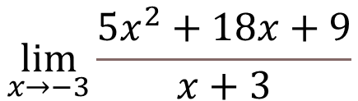
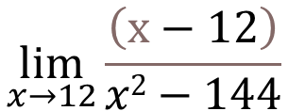
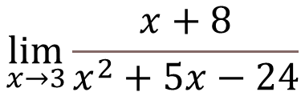
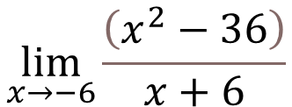
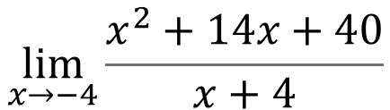
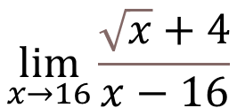

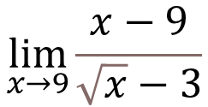
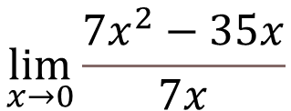

$$\lim_{x→3}\frac{x+8}{x^{2}+5x−24}$$
$$\lim_{x→−6}\frac{\left(x^{2}−36\right)}{x+6}$$
$$\lim_{x→12}\frac{\left(x−12\right)}{x2−144}$$
$$\lim_{x→−3}\frac{5x^{2}+18x+9}{x+3}$$
$$\lim_{x→\frac{5}{2}}\frac{2x−5}{2x^{2}−x−10}$$
$$\lim_{x→0}\frac{7x^{2}−35x}{7x}$$
$$\lim_{x→9}\frac{x−9}{\sqrt{x}−3}$$
$$\lim_{x→−5}\frac{x+5}{10x^{3}+50x^{2}}$$
$$\lim_{x→16}\frac{\sqrt{x}+4}{x−16}$$
$$\lim_{x→−4}\frac{x^{2}+14x+40}{x+4}$$

